Slide 1
Machine Learning…….
Traditional Programming
Data
Computer
Output
Program
Machine Learning
Data
Computer
Program
Output

Slide 2
Artificial Neural Network
Inputs
First Hidden layer
Second Hidden Layer
Output Layer

Slide 3
Signal Flow Backpropagation of Errors
Function Signals
Error Signals

Slide 4
Back Propagation network
A Back Propagation network learns by example.
You give the algorithm examples of what you want the network to do and it changes the network’s weights so that, when training is finished, it will give you the required output for a particular input.
Back Propagation networks are ideal for simple Pattern Recognition and Mapping Tasks
As mentioned, to train the network you need to give it examples of what you want – the output you want (called the Target) for a particular input.

Slide 5

ANN Training
The backpropagation algorithm looks for the minimum of the error function in weight space using the method of gradient descent.
The combination of weights which minimizes the error function is considered to be a solution of the learning problem.
Since this method requires computation of the gradient of the error function at each iteration step, we must guarantee the continuity and differentiability of the error function.
One of the more popular activation functions for backpropagation networks is the sigmoid, a real function S_{c} : IR →(0, 1) defined by the expression
$$\frac{1}{1+e^{−cx}}$$
S_{c}(x) =

Slide 6
Sigmoid function
Three sigmoid (for c = 1, c = 2 and c = 3)
Higher values of c bring the shape of the sigmoid closer to that of the step function
and in the limit c -> ∞ the sigmoid converges to a step function at the origin.

Slide 7
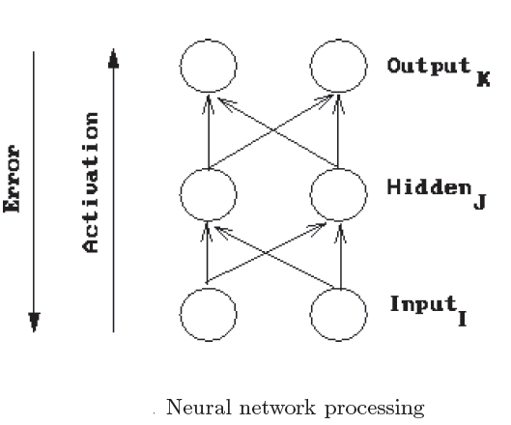
Conceptually, a network forward propagates activation to produce an output and it backward propagates error to determine weight changes.
The weights on the connections between neurons mediate the passed values in both directions.
The Backpropagation algorithm is used to learn the weights of a multilayer neural network with a fixed architecture.
It performs gradient descent to try to minimize the sum squared error between the network’s output values and the given target values.

Slide 8
Review of Calculus
Gradient Descent on Error
We can see the backpropagation learning algorithm as gradient descent on sum-squared error
(we square the error because we are interested in its magnitude, not its sign).
The total error in a network is given by the following equation
We want to adjust the network’s weights to reduce this overall error.

Slide 9
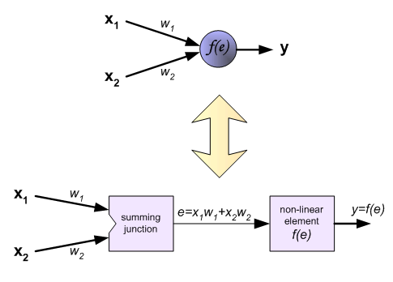
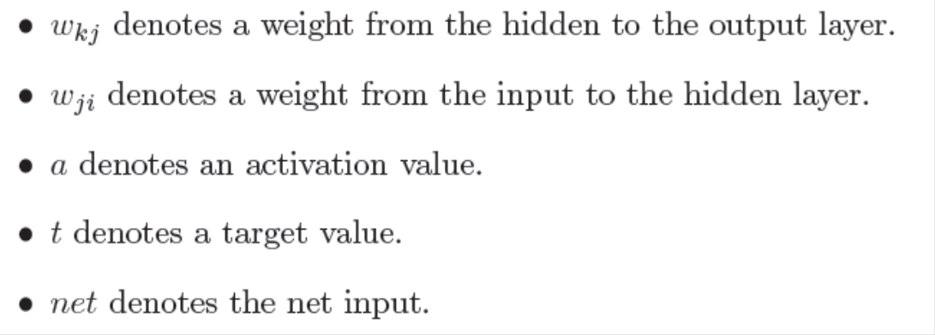
Lets begin at the output layer with a particular weight.
Error (E)=f(output(a_{k}))
where,
output=f(net input (net_{k}))
net input=f(weights)
However error is not directly a function of a weight.
The subscript k denotes the output layer.
The subscript j denotes the hidden layer.
The subscript i denotes the input layer.
Let’s consider each of these partial derivatives in turn. Note that only one term of the E summation will have a non-zero derivative: the one associated with the particular weight we are considering.

Slide 10
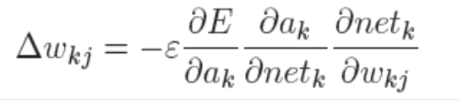
where,
Derivative of the error with respect to the activation
3. Derivative of the net input with respect to a weight
Note that only one term of the net summation will have a non-zero derivative: again the one associated with the particular weight we are considering.
2. Derivative of the activation with respect to the net input
Now as
Weight change rule for a hidden to output weight
we can rewrite the result of the partial derivative as:

Slide 11
Weight change rule for an input to hidden weight
Now we have to determine the appropriate weight change for an input to hidden weight. This is more complicated because it depends on the error at all of the nodes this weighted connection can lead to.

Slide 12

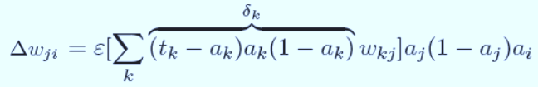
X
W_{ji}
a_{j}
W_{kj}
a_{k}
Network output
Σ
F
Σ
F
t_{k}
Target output
net_{j}= x_{i}*w_{ji}
a_{j}= sigmoid(net_{j})
net_{k}= aj*w_{kj}
a_{k}= sigmoid(net_{k})
a_{j}= sigmoid(x_{i}*w_{ji})
netk= sigmoid(netj)*w_{kj}
ak= sigmoid(aj*w_{kj})
net_{k}= sigmoid(x_{i}*w_{ji})*w_{kj}
a_{k}= sigmoid(sigmoid(x_{i}*w_{i})*w_{kj})

Slide 13
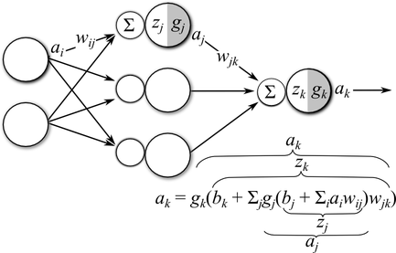

Slide 14
Learning by Example
Training Algorithm: backpropagation of errors using gradient descent training.
Colors:
Red: Current weights
Orange: Updated weights
Black boxes: Inputs and outputs to a neuron
Blue: Sensitivities at each layer

Slide 15
First Pass
G1= (0.6225)(1-0.6225)(0.0397)(0.5)(2)=0.0093
G2= (0.6508)(1-0.6508)(0.3492)(0.5)=0.0397
0.6225
0.6225
0.6508
0.5
0.5
0.5
0.6508
0.5
1
0.5
0.5
0.5
0.5
0.6508
0.5
0.6225
0.5
0.6225
0.6508
Gradient of the neuron= G =slope of the transfer function×[Σ{(weight of the neuron to the next neuron) × (output of the neuron)}]
Gradient of the output neuron = slope of the transfer function × error
G3=(1)(0.3492)=0.3492
Error=1-0.6508=0.3492

Slide 16
Weight Update 1
New Weight=Old Weight + {(learning rate)(gradient)(prior output)}
0.5+(0.5)(0.0397)(0.6225)
0.5+(0.5)(0.3492)(0.6508)
0.5+(0.5)(0.0093)(1)
0.5124
0.5047
0.6136
0.5124
0.5124
0.5047
0.6136
0.5124

Slide 17
Second Pass
G1= (0.6236)(1-0.6236)(0.5124)(0.0273)(2)=0.0066
G2= (0.6545)(1-0.6545)(0.1967)(0.6136)=0.0273
0.6236
0.6391
0.6545
0.5047
0.5124
0.6136
0.8033
0.5047
1
0.5124
0.5124
0.5047
0.6136
0.8033
0.5047
0.5124
0.6236
0.6391
0.6545
G3=(1)(0.1967)=0.1967
Error=1-0.8033=0.1967

Slide 18
Weight Update 2
New Weight=Old Weight + {(learning rate)(gradient)(prior output)}
0.5124+(0.5)(0.0273)(0.6236)
0.6136+(0.5)(0.1967)(0.6545)
0.5047+(0.5)(0.0066)(1)
0.5209
0.508
0.6779
0.5209
0.5209
0.508
0.6779
0.5209

Slide 19
Third Pass
0.6243
0.6504
0.508
0.6571
0.5209
0.6779
0.8909
0.508
1
0.5209
0.5209
0.508
0.6779
0.508
0.5209
0.6571
0.8909
0.6243
0.6504

Slide 20
Weight Update Summary
W1: Weights from the input to the input layer
W2: Weights from the input layer to the hidden layer
W3: Weights from the hidden layer to the output layer

Slide 21
Training Algorithm
The process of feedforward and backpropagation continues until the required mean squared error has been reached.
Typical MSE : 1e-5
Other complicated backpropagation training algorithms also available.

Slide 22
